Slide 1
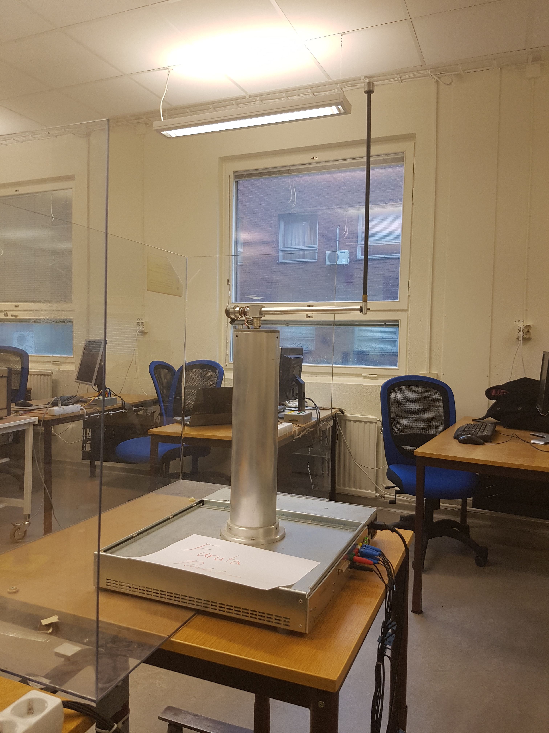
Adaptive friction compensation of inverted pedulum.
Notes:
Process
Yields limit cycles due to friction when controlled in top position
Estimate friction in controlled test in bottom position or in real time in top position.
Estimation using recursive least squares.
Swing up - lyaponov
Top controller – LQR
Using a lab in non linear control as a basis

Slide 2
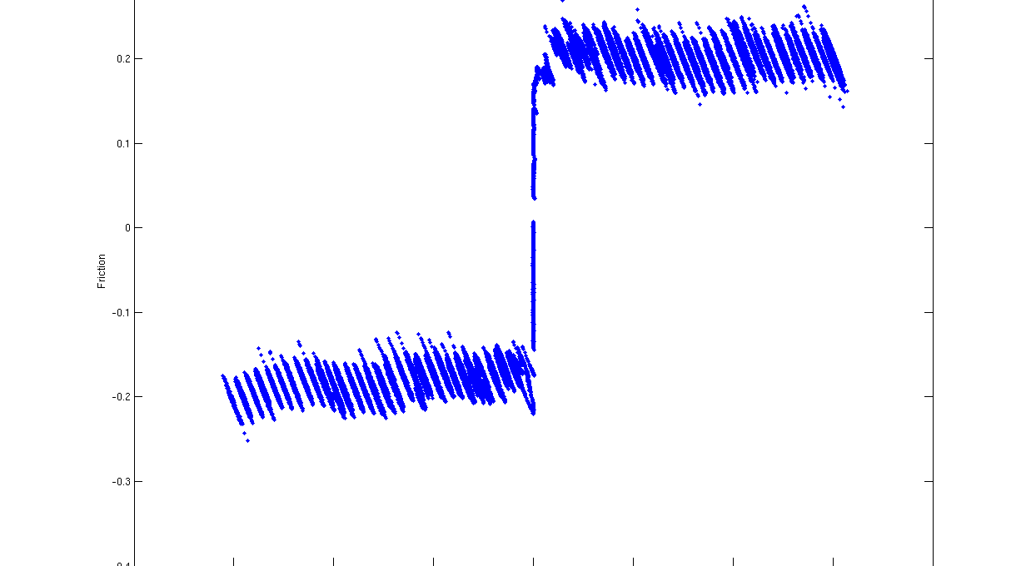
Estimated friction for different velocities
Notes:
Offline friction estimation in the lower position.
Both friction models might be viable.
As one can see it seems that the friction varies with the arm position.

Slide 3
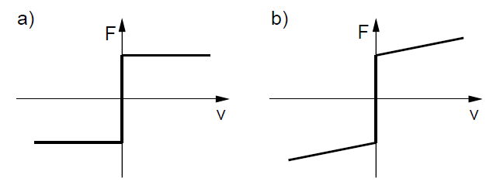
Friction models
a) Coulomb friction model
b) Coulomb + viscosity friction model
Notes:
Different friction models to consider. Focus on simple models due to low speeds and noisy measurements.

Slide 4
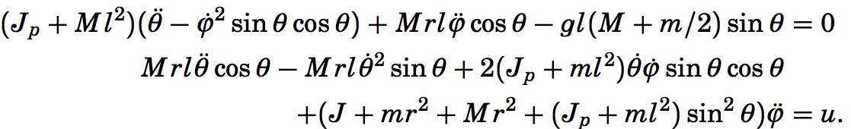
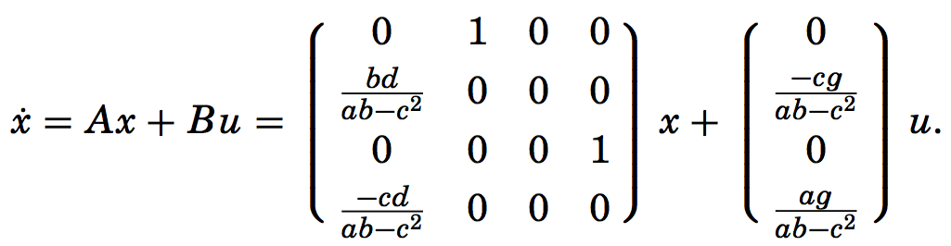
Simplified dynamics
Linearized model
Notes:
Since the pendulum dynamics are quite complicated these simplified dynamics where given in the non linear control lab. The dynamics where simplified using some lagrangian theory.
The model was then linearized around the top since this is where we want to estimate the friction.

Slide 5
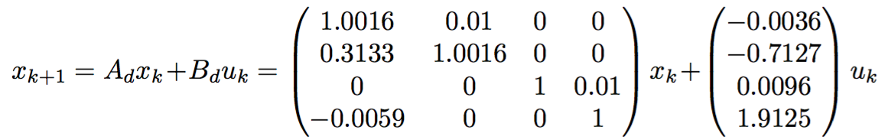
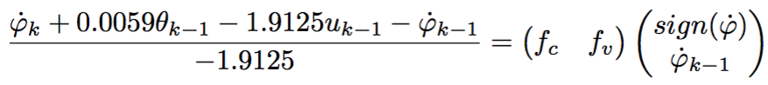
Discretized model
Model with friction
Friction equation
Notes:
This model was discretized using the c2d command in matlab which uses zero order hold.
Then we added friction to our model, we consider the friction as a torque and thus we remove it from the given control signal.
With the coloumb + viscouse friction model as a basis we arrive at this equation for the recursive least squares estimation using the fourth state.
The fourth state is chosen since we get both the dynamics of the arm and pendulum in that equation.

Slide 6
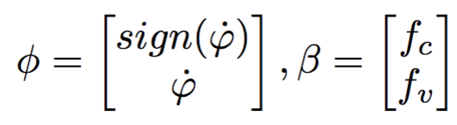
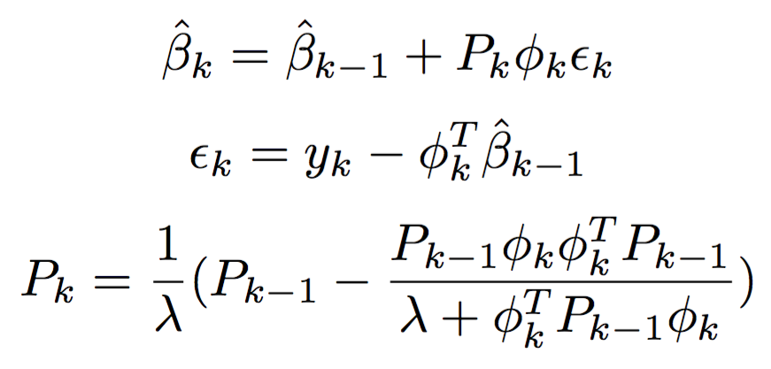
RLS ALGORITHM

Slide 7
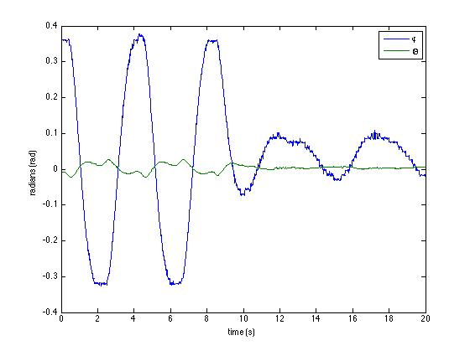
Limit Cycles without and with friction compensation
Notes:
Very good, offset due to different friction in different directions

Slide 8
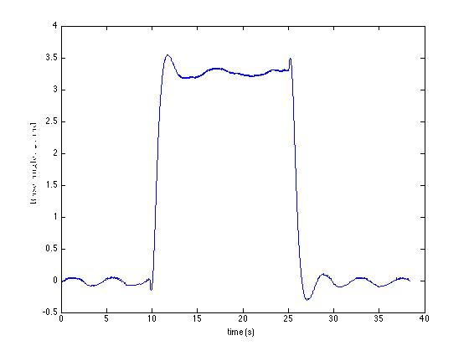

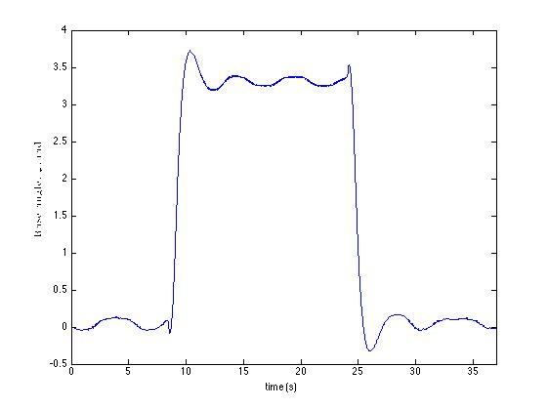
Coloumb+Viscouse friction model
Coloumb friction
model
Notes:
Very little difference! For these low speeds one can use either model.

Slide 9
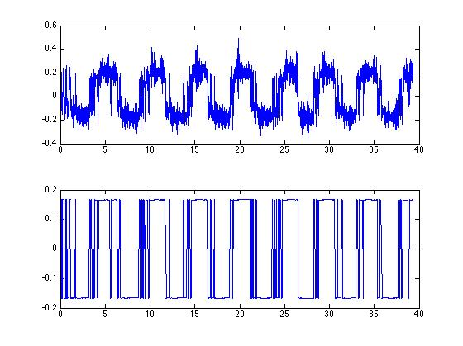
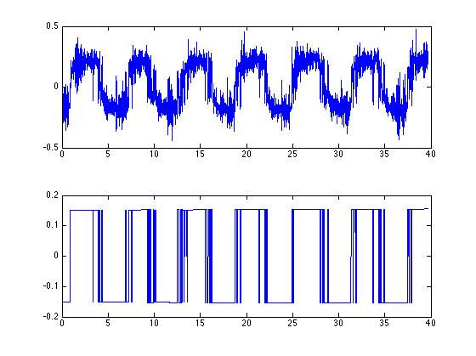
Calculated friction
Coloumb+Viscouse friction model
Estimated friction
Calculated friction
Coloumb friction model
Estimated friction
Notes:
Both can track the friction well. (RLS estimation without compensation and then compensation with good parameters.)

Slide 10
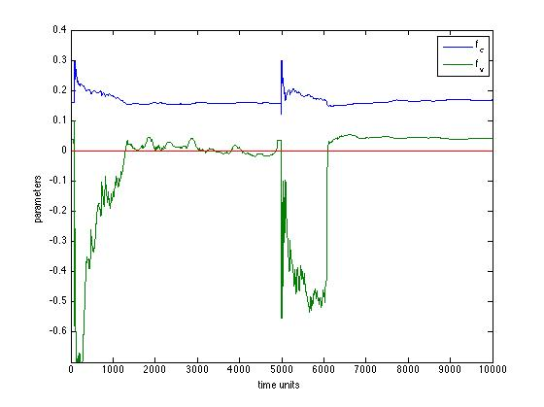
RLS convergence without and with external excitation
Notes:
Different RLS convergence, lambda = 1 since very noisy signals and our parameters should not change over time.

Slide 11
